Slide 1
COMPUTER ORGANIZATION AND ARCHITECTURE
Dr. Rizwan Khan
Head – Department of Computer Science and Engineering
(An NBA Accredited Program)
ABES Institute of Technology, Ghaziabad

Slide 2
MAIN MEMORY
Main Memory
RAM and ROM Chips
Typical RAM chip
Chip select 1
CS1
Chip select 2
CS2
128 x 8
Read
RD
RAM
8-bit data bus
Write
WR
7-bit address
AD 7
CS1 CS2 RD WR
Memory function
State of data bus
0 0 x x
Inhibit
High-impedence
0 1 x x
Inhibit
High-impedence
1 0 0 0
Inhibit
High-impedence
1 0 0 1
Write
Input data to RAM
1 0 1 x
Read
Output data from RAM
1 1 x x
Inhibit
High-impedence
Typical ROM chip
Chip select 1
CS1
Chip select 2
CS2
512 x 8
8-bit data bus
ROM
9-bit address
AD 9

Slide 3





MEMORY ADDRESS MAP
Main Memory
Address space assignment to each memory chip
Example: 512 bytes RAM and 512 bytes ROM
Hexa
address
Address bus
Component
10 9 8 7 6 5 4 3 2 1
RAM 1
RAM 2
RAM 3
RAM 4
ROM
0000 - 007F
0080 - 00FF
0100 - 017F
0180 - 01FF
0200 - 03FF
0 0 0 x x x x x x x
0 0 1 x x x x x x x
0 1 0 x x x x x x x
0 1 1 x x x x x x x
1 x x x x x x x x x
Memory Connection to CPU
- RAM and ROM chips are connected to a CPU
through the data and address buses
- The low-order lines in the address bus select
the byte within the chips and other lines in the
address bus select a particular chip through
its chip select inputs

Slide 4
CONNECTION OF MEMORY TO CPU
Main Memory
Address bus
CPU
16-11
10
9
8
7-1
RD
WR
Data bus
Decoder
3
2
1
0
CS1
CS2
128 x 8
Data
RD
RAM 1
WR
AD7
CS1
CS2
128 x 8
Data
RD
RAM 2
WR
AD7
CS1
CS2
128 x 8
Data
RD
RAM 3
WR
AD7
CS1
CS2
128 x 8
Data
RD
RAM 4
WR
AD7
CS1
1- 7
CS2
512 x 8
Data
8
AD9
ROM
9

Slide 5
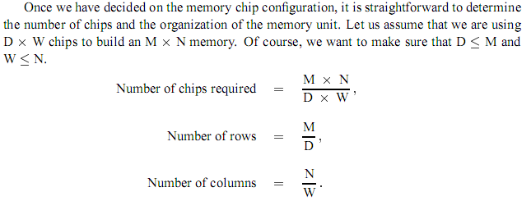
Making Larger Memories

Slide 6
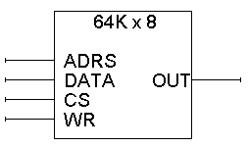
Bigger RAMs from smaller RAMs
We can use small RAMs as building blocks for making larger memories.
As an example, suppose we have some 64K x 8 RAMs to start with:
64K = 2⁶ x 2¹⁰ = 2¹⁶, so there are 16 address lines.
There are 8 data lines.
16
8
8

Slide 7
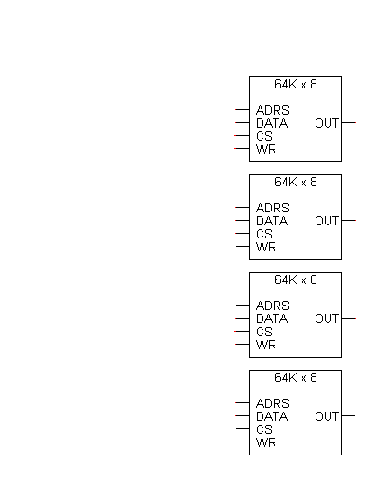
Making a larger memory
We can put ?? 64K x 8 chips together to make a 256K x 8 memory.
For 256K words, we need ?? address lines.

Slide 8
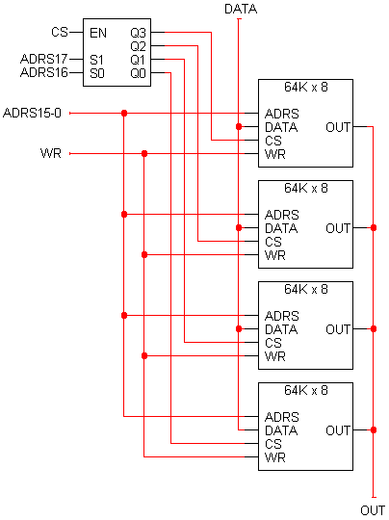
Making a larger memory
We can put four 64K x 8 chips together to make a 256K x 8 memory.
For 256K words, we need 18 address lines.
The two most significant address lines go to the decoder, which selects one of the four 64K x 8 RAM chips.
The other 16 address lines are shared by the 64K x 8 chips.
The 64K x 8 chips also share WR and DATA inputs.
This assumes the 64K x 8 chips have three-state outputs.
8
16
8

Slide 9
Analyzing the 256K x 8 RAM
There are 256K words of memory, spread out among the four smaller 64K x 8 RAM chips.
When the two most significant bits of the address are 00, the bottom RAM chip is selected. It holds data for the first 64K addresses.
The next chip up is enabled when the address starts with 01. It holds data for the second 64K addresses.
The third chip up holds data for the next 64K addresses.
The final chip contains the data of the final 64K addresses.
8
16
8

Slide 10
Address ranges
8
16
11 1111 1111 1111 1111 (0x3ffff)
to
11 0000 0000 0000 0000 (0x30000)
10 1111 1111 1111 1111 (0x2ffff)
to
10 0000 0000 0000 0000 (0x20000)
01 1111 1111 1111 1111 (0x1ffff)
to
01 0000 0000 0000 0000 (0x10000)
00 1111 1111 1111 1111 (0x0ffff)
to
00 0000 0000 0000 0000 (0x00000)
8

Slide 11


